Slide 1
Usage of Deep Learning and Blockchain in Compilation and Copyright Protection of Digital Music
Team No. 28
ID: 20101477
Name: Md. Sifat Mahmud
ST name: Farah and Sania

Slide 2
Introduction
Music plays a central role in our lives.
Deep learning and blockchain are emerging technologies with potential to revolutionize music.
This research explores their application in algorithmic composition and copyright protection.

Slide 3
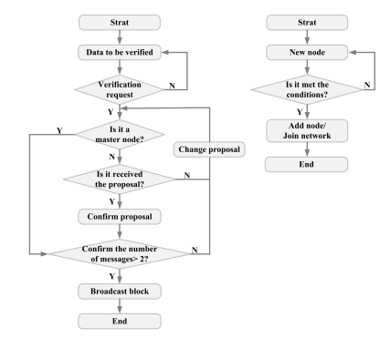
Blockchain for Digital Music Copyright Protection
Blockchain technology ensures secure and transparent copyright management.
Proposed system:
Utilizes IPBFT consensus algorithm for efficient and accurate copyright registration.
Offers high throughput and smooth operation.
Fig: Calculating flowchart of IPBFT.

Slide 4
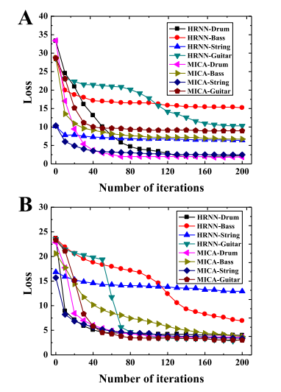
Performance Evaluation
Simulation and JMeter testing conducted.
Music composition models:
DCGANs and MICA achieved high accuracy, harmony, and fidelity.
Copyright protection system:
Demonstrated impressive throughput and accurate concurrent operations.
Acknowledged limitations:
Reliance on simulation-based evaluation.
Fig: Analysis on multi-task learning effects of MICA model (A indicated the learning effect of the music sequence with common length; B gave the learning effect of the music sequence with long length).

Slide 5
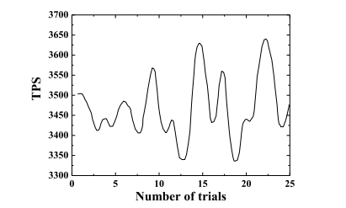
Future Scope and Conclusion
Potential applications:
Music production (generating new music, personalized soundtracks, assisting composers).
Music education (interactive and personalized learning experiences).
Copyright protection (various creative industries).
Future research:
Enhance security of the system.
Facilitate real-world implementation.
Explore applications in other creative fields (music therapy, game development).
Results:
Deep learning and blockchain hold immense potential for music technology.
This research contributes to advancing their application in music creation and protection.
Fig: Test results of throughput of IPBFT algorithm.

Slide 6
Thank You

